Slide 1


Whole Microscope Incubation
Zeiss Nikon Olympus Leica Platforms

Slide 2
Our Company
* 1995 First Time Lapse Microscopy Launched
* 2010 First Incubation Systems Developed
* 2014 Worlds First Vibration Free Incubation System
* 2017 Product Development with Oxford University
Our Products
Heating
Cooling
Gas Control
* Chamber and Stage Type Incubation
* Chamber and Stage Based Cooling
* Multiple CO₂ O₂ Gas Control Solutions

Slide 3





Our Customers Major Universities and Research Institutes

Slide 4
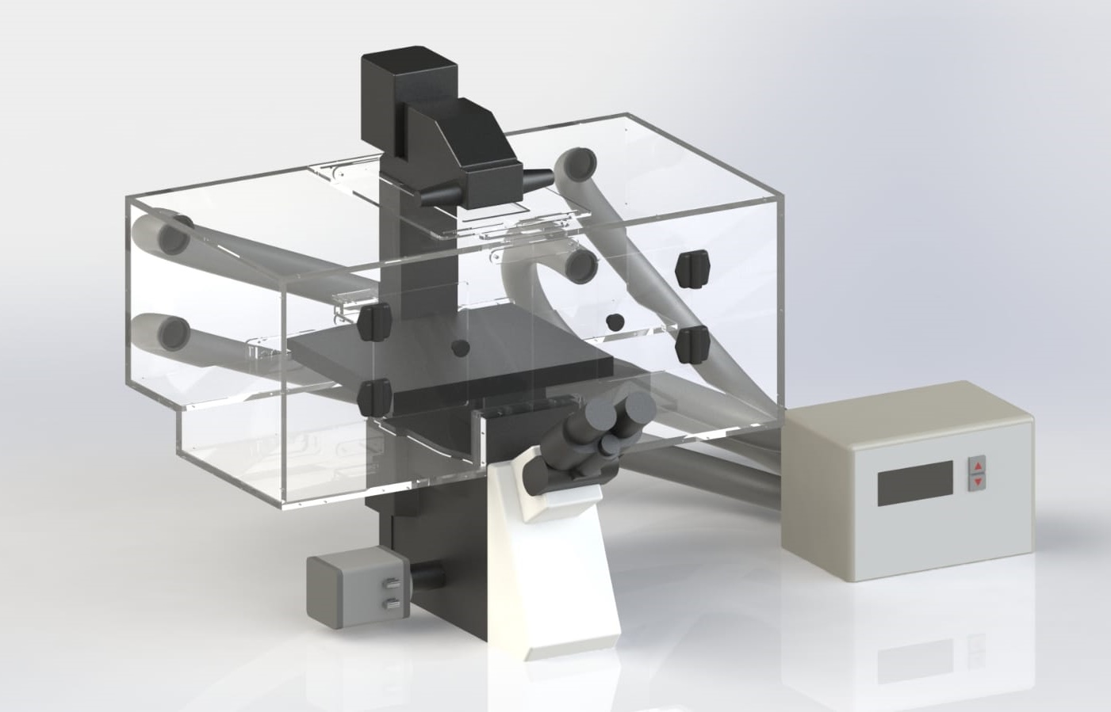
Traditional Fan System
Vibration
Fans- Noisy Environment
Pipes- Require more fitting space
Introduces External Dirty Air
Limited Range 30-42ºC
No Chamber Modifications Possible
Moving Parts- Reduced Reliability

Slide 5
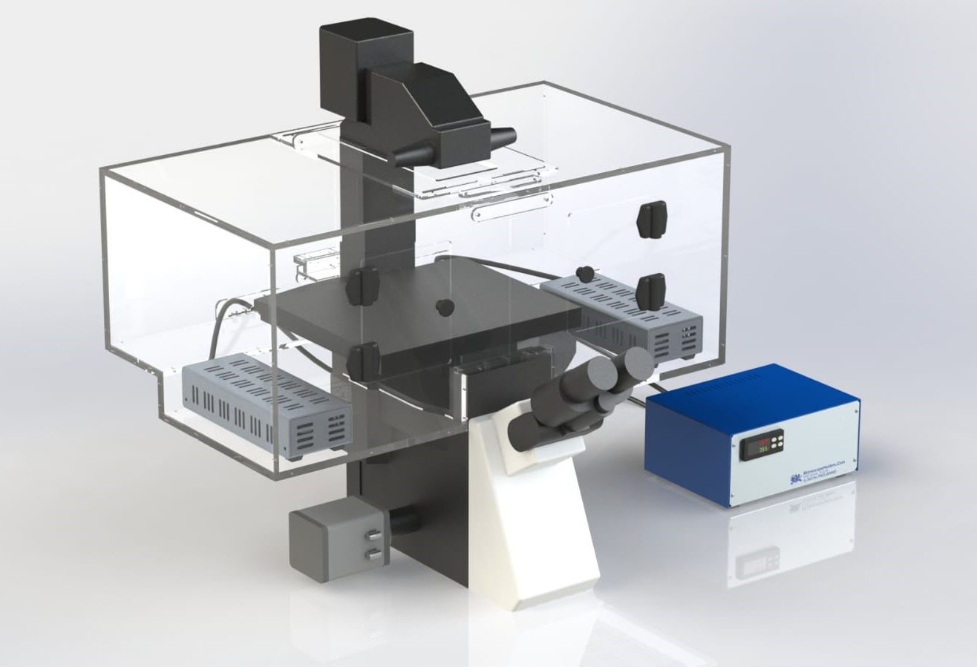
Vibration Free- The Future
* No Vibration No Fans No Pipes
No Noise
* Extended Temperature Range
18-42ºC Convection
* Dual Convection Heaters
No Gradients
No Dirty Air
* No Support Pillars Better Access
Panel Assembled Allows Chamber Modification
* Green Technology 90% Less Power than Fan Systems
No Moving Parts- Better Reliability
72 Hour Replacement Policy

Slide 6
Temperature Stability Data
Tº C
40
30
20
Hours 0 12 24 36 48 60 72
Source: University of Heidelberg Germany

Slide 7
James Flewellyn
The Francis Crick Institute London
What our Clients Say About Us…..
“We use the system for live cell TIRF and epi-fluorescence imaging and magnetic tweezer experiments. Our incubation chamber was made to fit a bespoke microscope, MicroscopeHeaters adjusted the chamber to our needs, providing drop-in panels to modify our microscope system through our development phase”
Dr. Jens Eriksson,
Uppsala University, Sweden
"I'm very pleased with our microscope heating system from Digital Pixel. At our facility we are routinely running 72 hours long time lapse experiments on primary cells without any issues with it. What really sets the system apart from any other that I have been working with over the past 10 years, is that it is completely silent.

Slide 8
Zeiss Confocal
University of Oxford

Slide 9
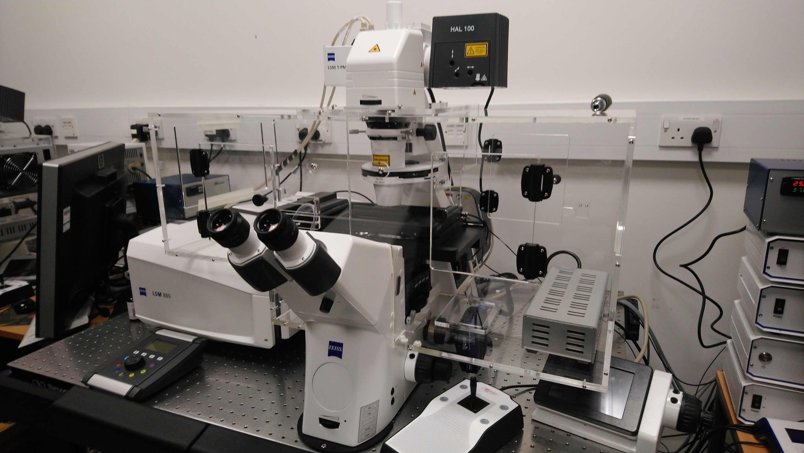

Slide 10
Leica DMi8 SP8
University of Southampton

Slide 11
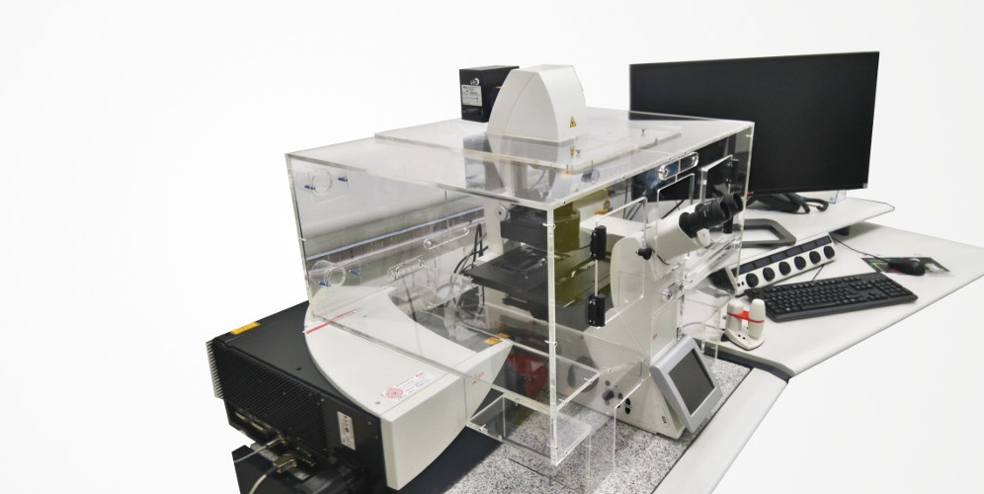

Slide 12
Nikon TI-2
CrestOptics V3
University of Cambridge

Slide 13
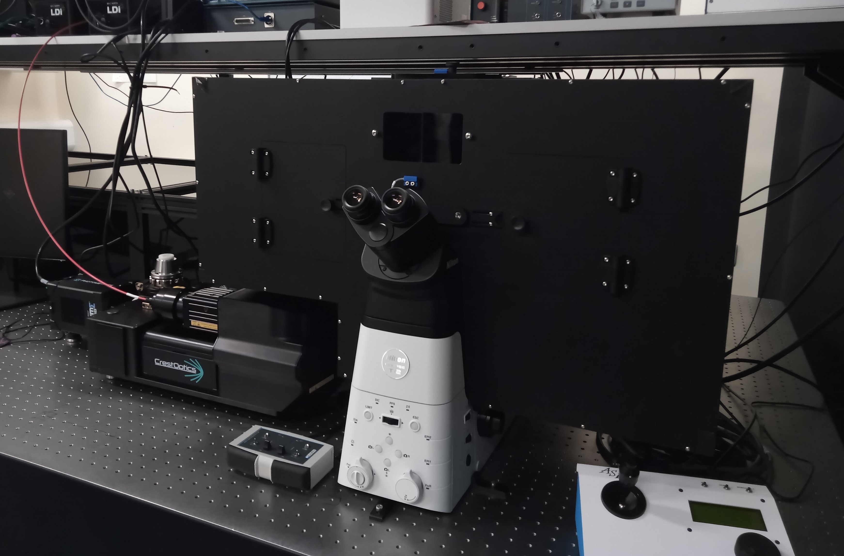

Slide 14
Olympus IX83 TIRF Demanding Imaging
University of Oxford

Slide 15
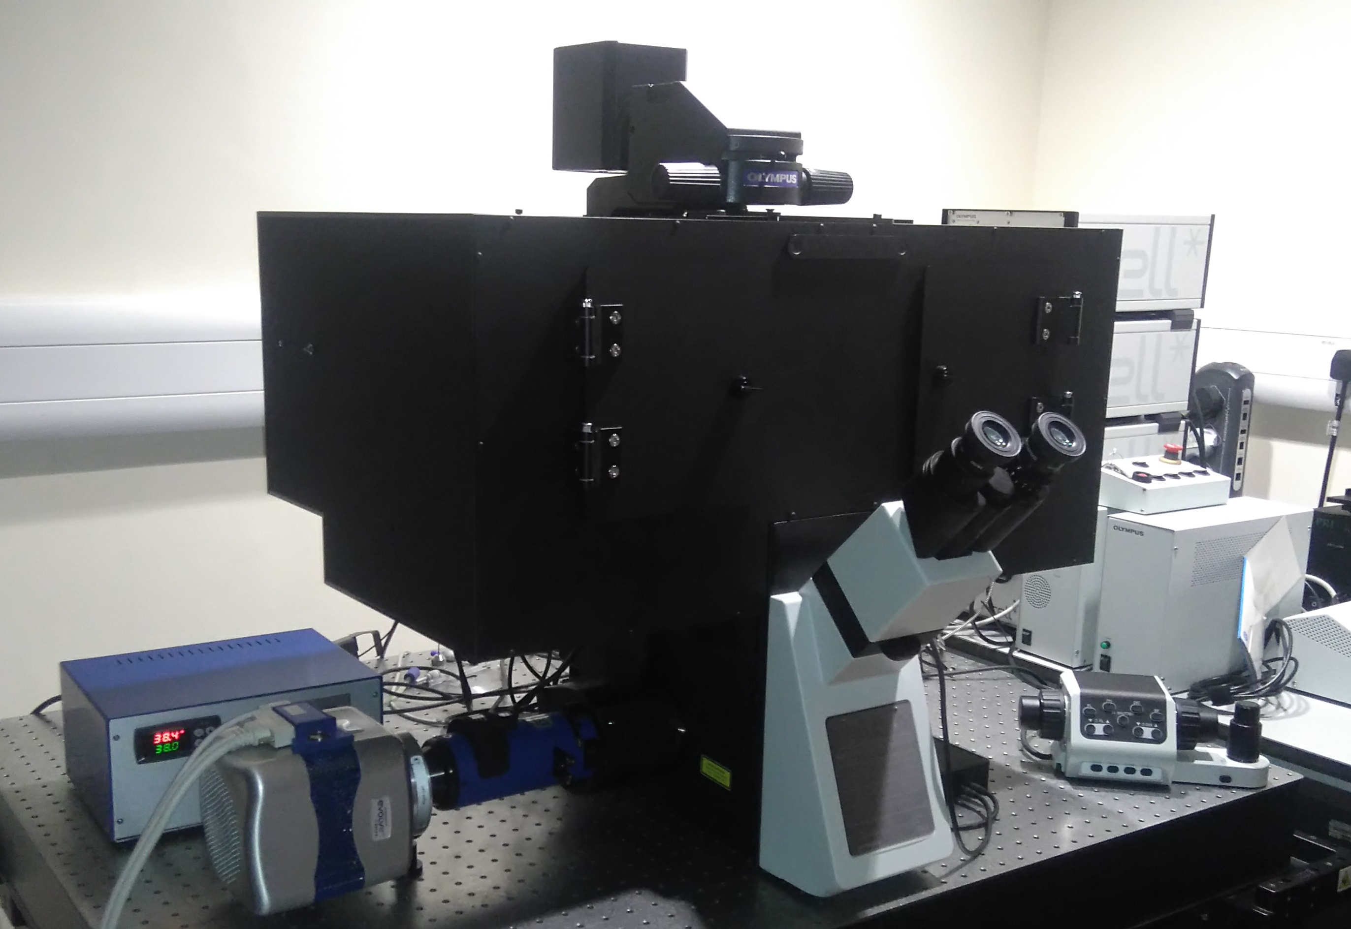

Slide 16
Olympus IX83
PicoQuant FLIM
San Diego

Slide 17
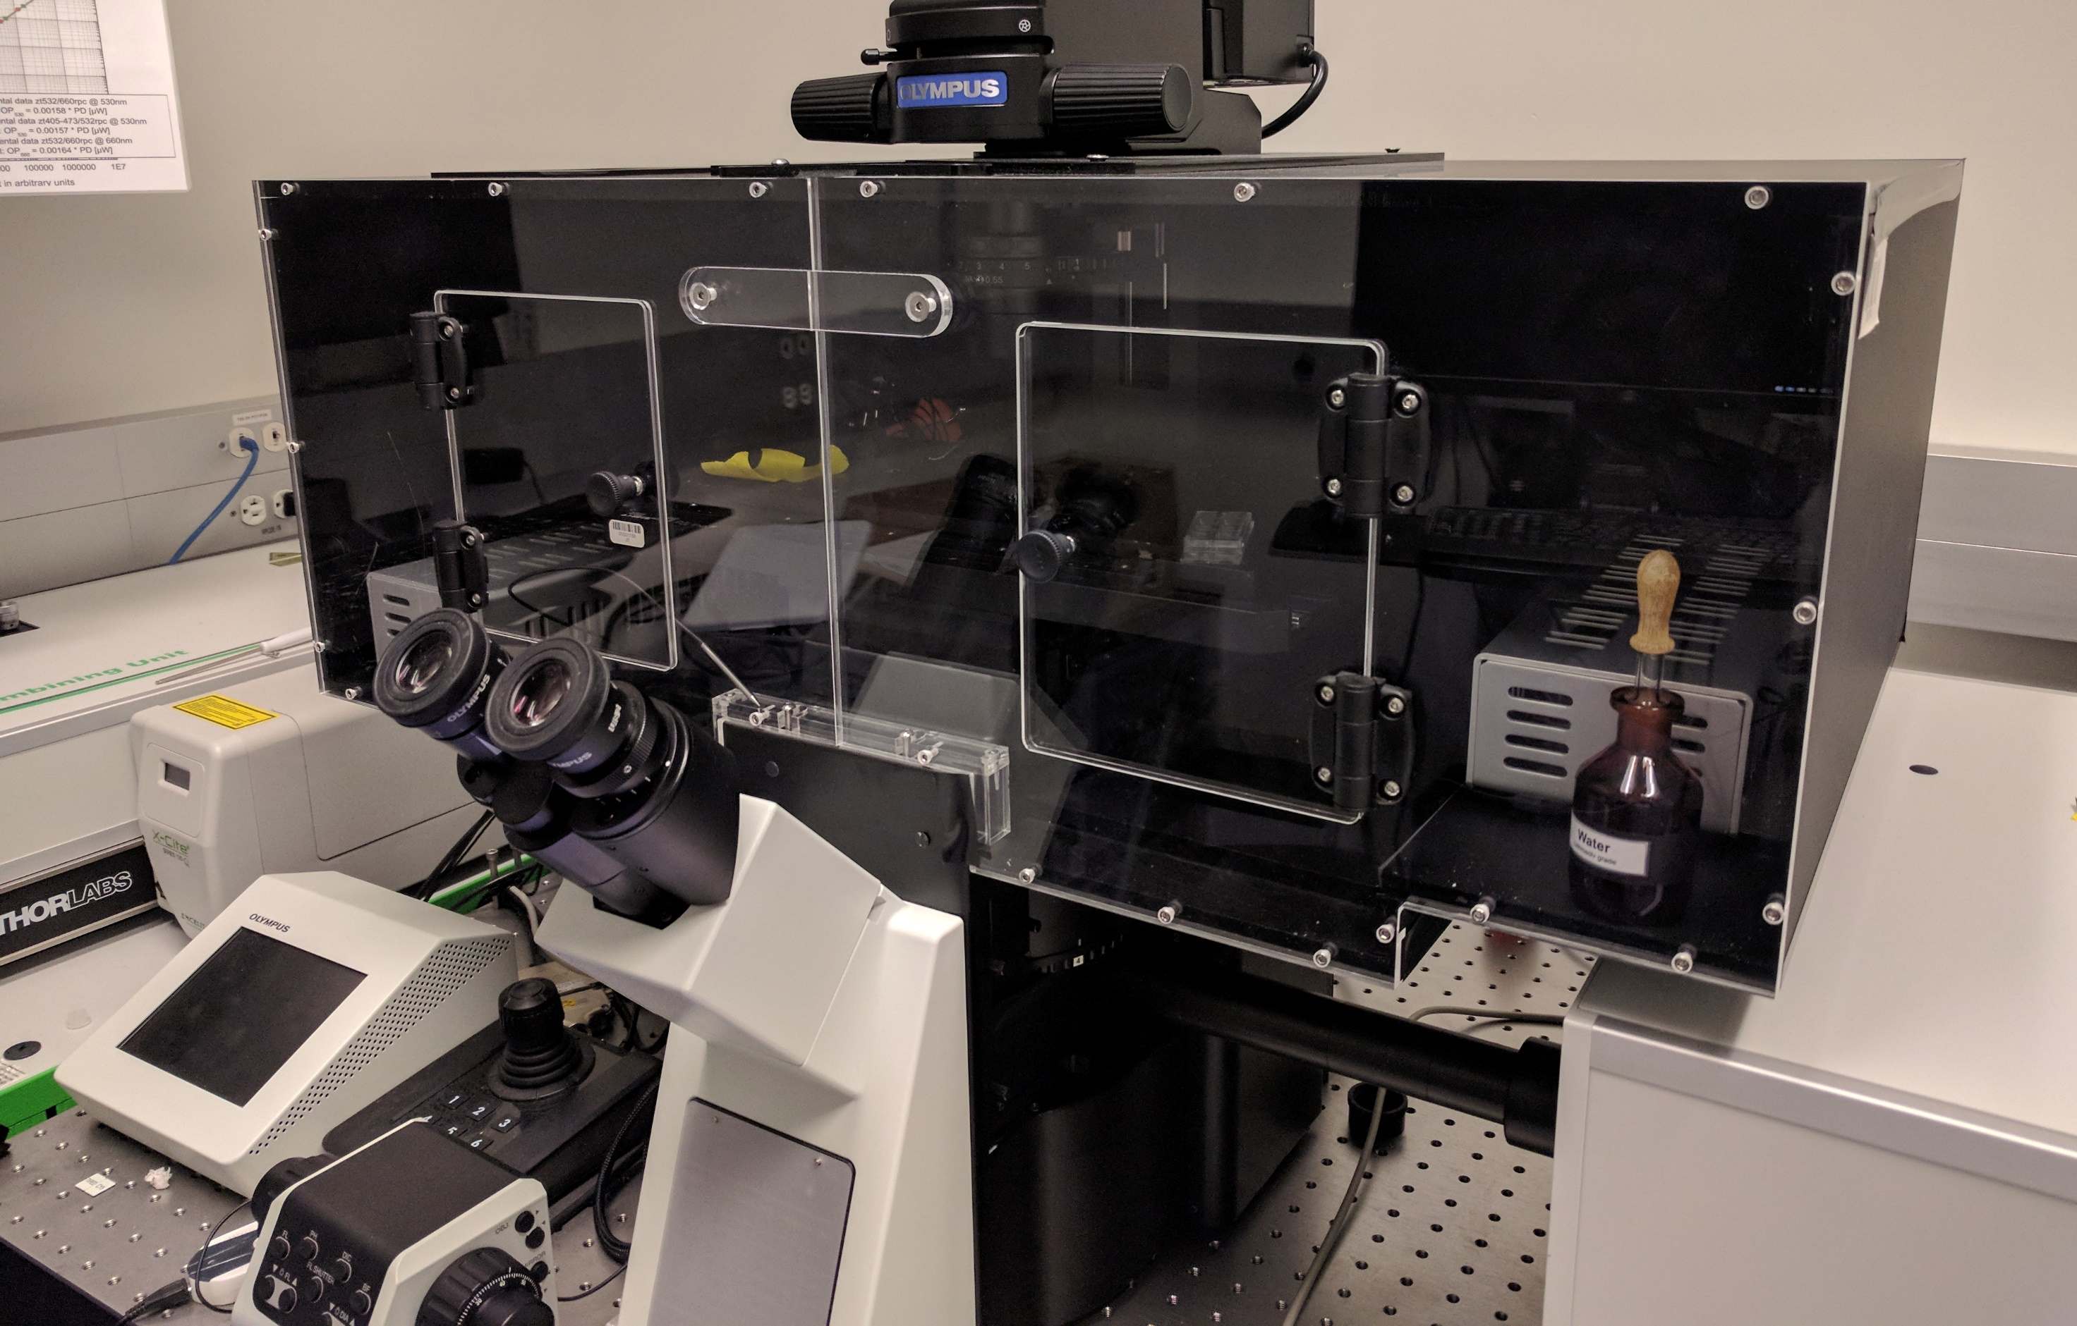

Slide 18
Olympus IX73
Yeast Single Molecule Imaging
University of Sussex

Slide 19
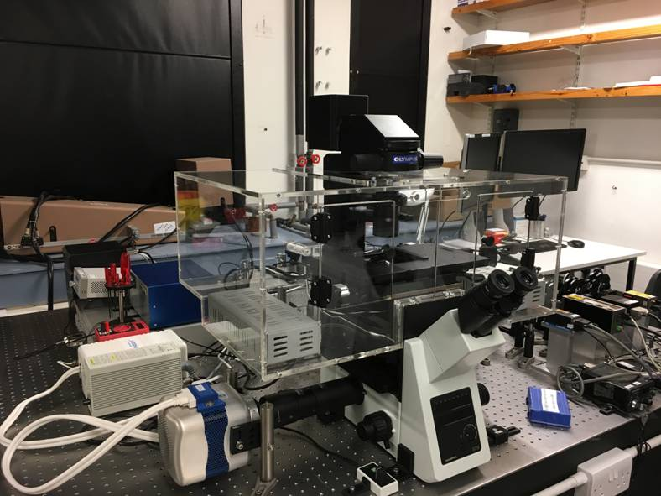

Slide 20
Ordering Information- Chamber Incubation and CO₂ Control:
Model Colour Layer Option Microscope Modality
IX71 CL/MB/MBC N/A WDF/CREST_v3/YOKO/CONFOCAL
IX81 CL/MB/MBC N/A WDF/CREST_v3/YOKO/CONFOCAL
IX73 CL/MB/MBC 1L/2L WDF/CREST_v3/YOKO/CONFOCAL
IX83 CL/MB/MBC 1L/2L WDF/CREST_v3/YOKO/CONFOCAL
i.e. IX83, 2 layers, Clear with Crest_v3 is : IX83_CL_2L_CREST_v3
Gas Controller
DP_CO2_MIX_0_18 Microprocessor Controlled CO2 Controller 0-18% CO2 range
DP_SEAL_INSERT K-Type sealed insert with glass lid, for 96 well, 35mm Petri and 75x25mm slide sample holder.
OLY_STAGE_PLATE Adaptor plate to for K-type to Olympus Stage
.
All Systems Include:
DP_MTC_2000 Microprocessor Temperature Controller
DP_150_VF Two Vibration Free Heater Modules.
DP-PT100_TS Stainless Steel Temperature Sensor
Tt
Notes:
Colour: CL=Clear MB=Matt Black
MBC= Matt Black with Clear Front
Layer 1L= One Layer
2L= Two Layer Option
Microscope WDF=Widefield CREST_v3
YOKO=YOGOGAWA CONFOCAL
Tt

Slide 21
Ordering Information- Chamber Incubation and CO₂ Control:
Model Colour Layer Option Microscope Modality
IX71 CL/MB/MBC N/A WDF/CREST_v3/YOKO/CONFOCAL
IX81 CL/MB/MBC N/A WDF/CREST_v3/YOKO/CONFOCAL
IX73 CL/MB/MBC 1L/2L WDF/CREST_v3/YOKO/CONFOCAL
IX83 CL/MB/MBC 1L/2L WDF/CREST_v3/YOKO/CONFOCAL
i.e. IX83, 2 layers, Clear with Crest_v3 is : IX83_CL_2L_CREST_v3
Gas Controller
DP_CO2_MIX_0_18 Microprocessor Controlled CO2 Controller 0-18% CO2 range
DP_SEAL_INSERT K-Type sealed insert with glass lid, for 96 well, 35mm Petri and 75x25mm slide sample holder.
OLY_STAGE_PLATE Adaptor plate to for K-type to Olympus Stage
.
All Systems Include:
DP_MTC_2000 Microprocessor Temperature Controller
DP_150_VF Two Vibration Free Heater Modules.
DP-PT100_TS Stainless Steel Temperature Sensor
Tt
Notes:
Colour: CL=Clear MB=Matt Black
MBC= Matt Black with Clear Front
Layer 1L= One Layer
2L= Two Layer Option
Microscope WDF=Widefield CREST_v3
YOKO=YOGOGAWA CONFOCAL
Tt

Slide 22
Want to Know More? Please Get in Touch
Digital Pixel Cell Viability and Microscopy Solutions
Science Park Square
Brighton BN1 9SB
Tel: 0044 1273 502176
www.microscopeheaters.com
support@digitalpixel.co.uk

